Slide 1
Subway Station Hazard Detection
Pascal Fischer, Felix Hoffmann, Edis Kurtanovic, Martin Ludwig, Alen Smajic
Project Presentation
Module: Systems Engineering Meets Life Sciences II SoSe 2020
Supervisors: Prof. V. Ramesh, Dr. M. Rammensee

Slide 2
Overview
User View (Edis)
Modeler View (Felix)
Implementation View (Alen & Pascal)
Validation View (Edis & Martin)
Summary & Outlook

Slide 3
User View
Edis Kurtanovic

Slide 4
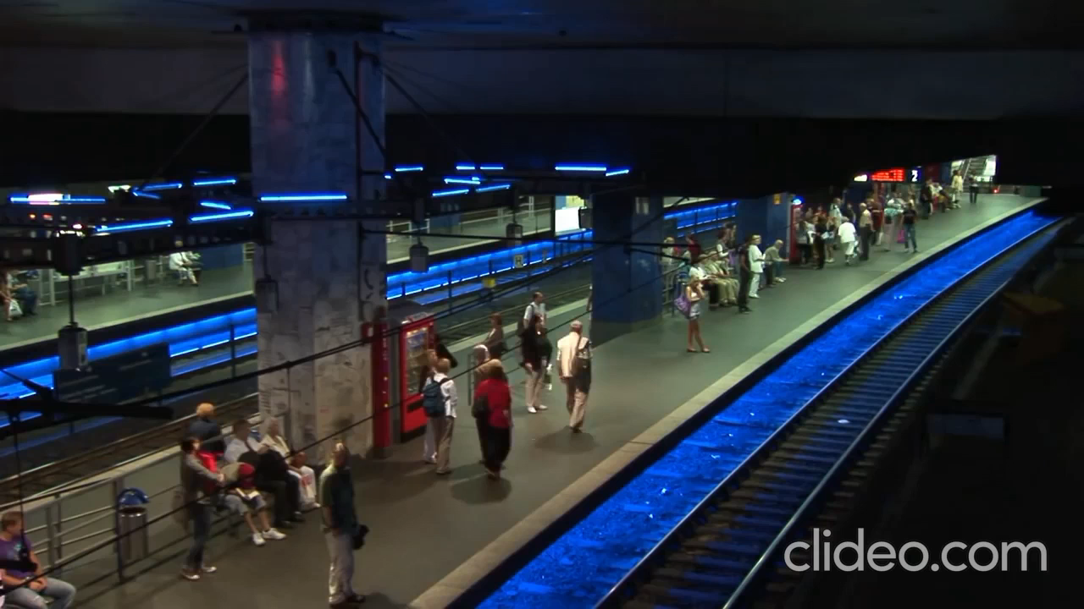
Context

Slide 5
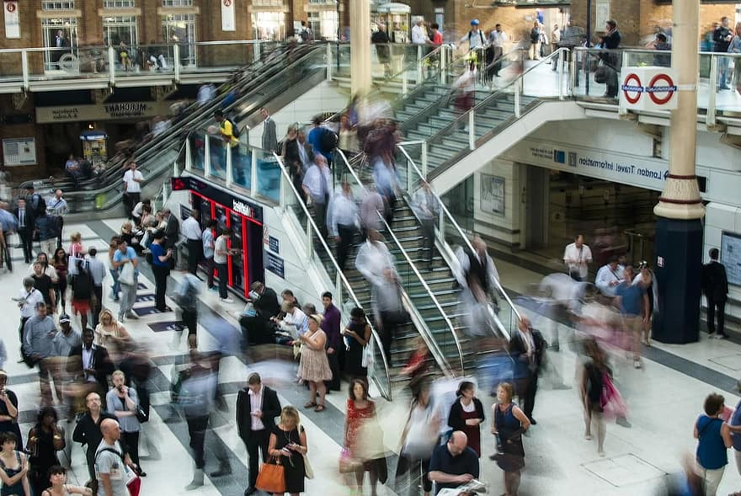
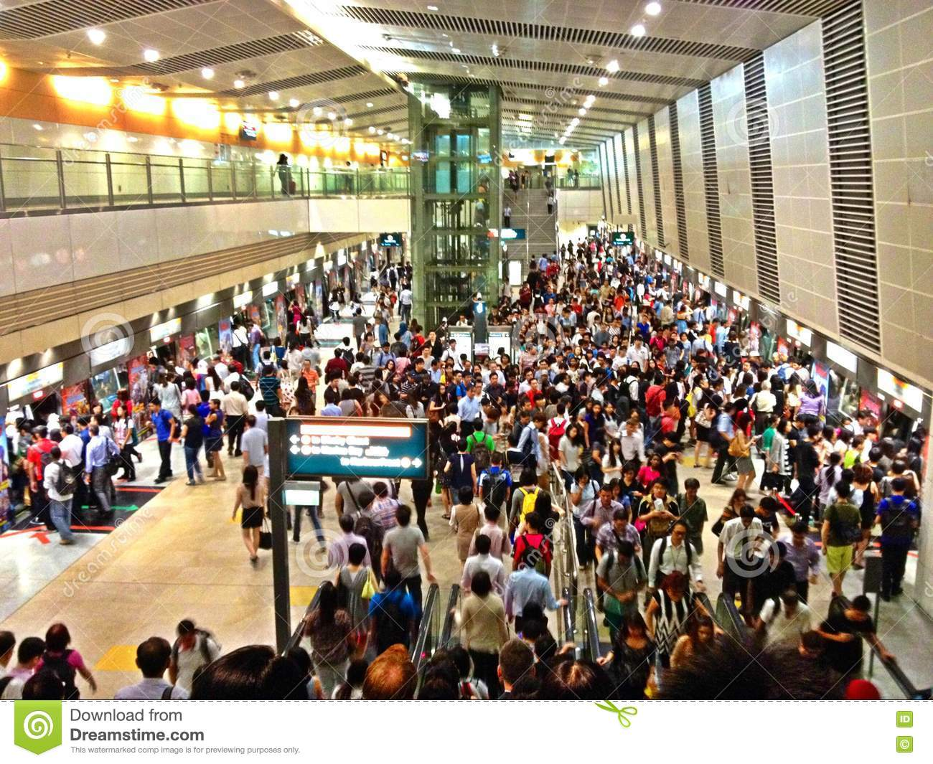
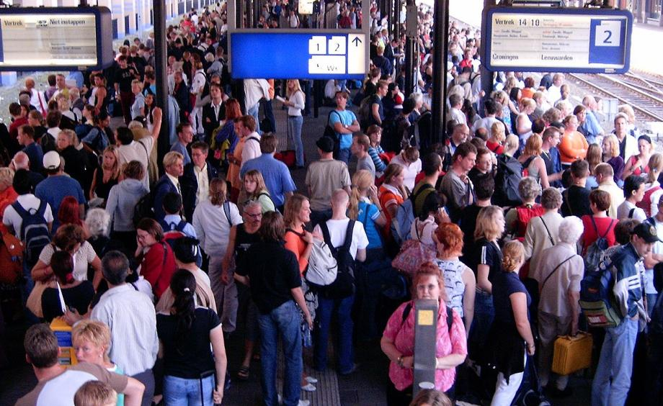
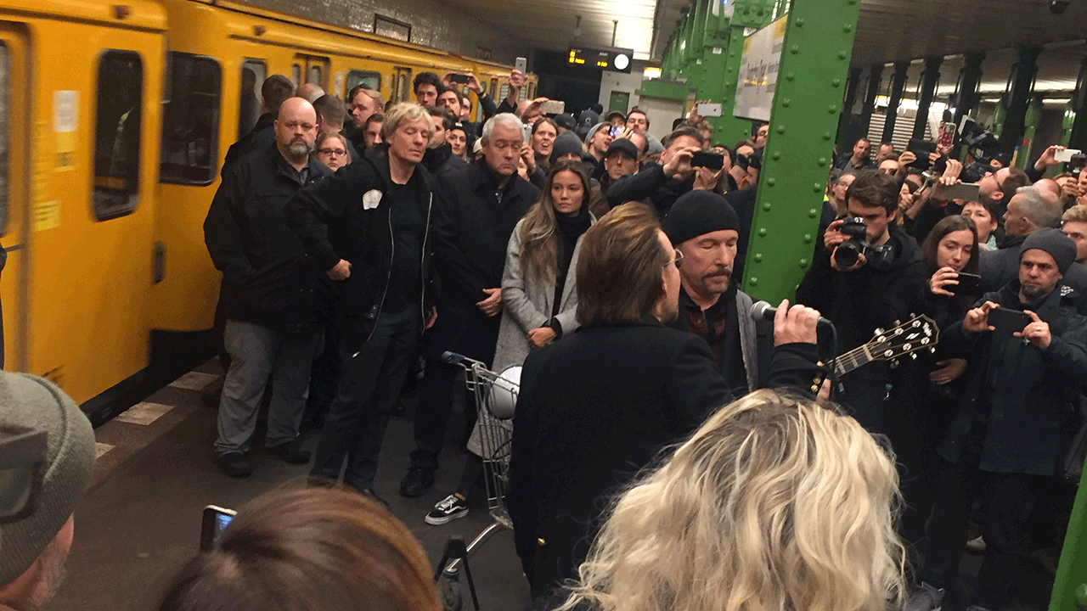
Context

Slide 6


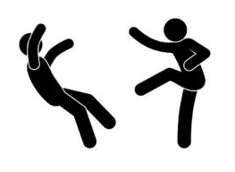

Context

Slide 7
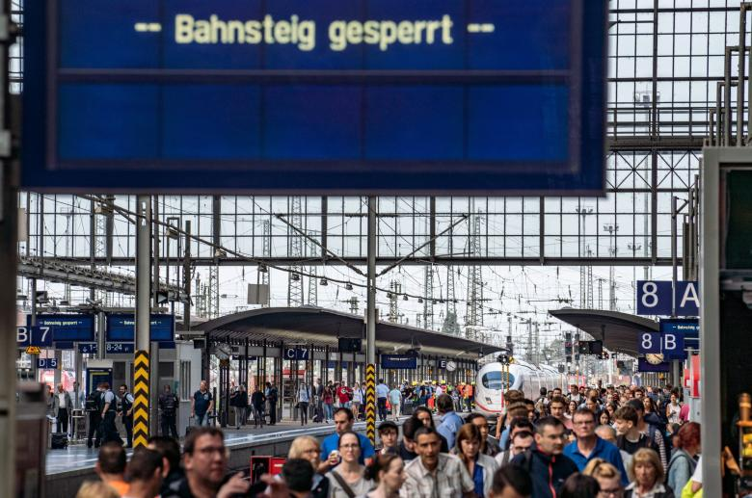
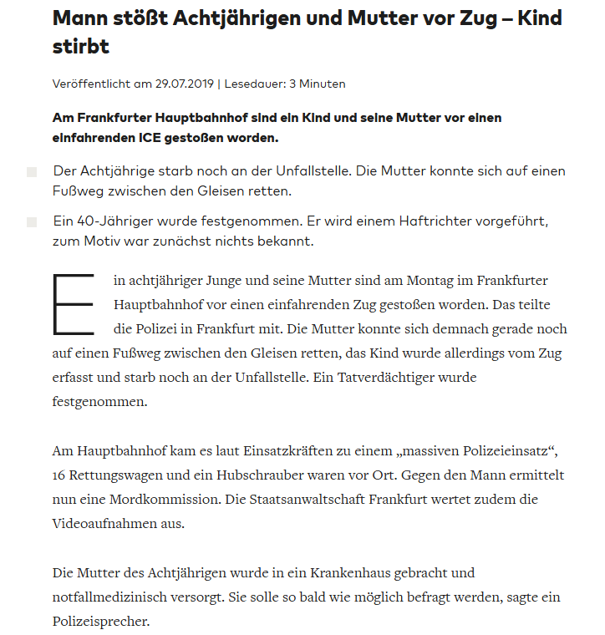
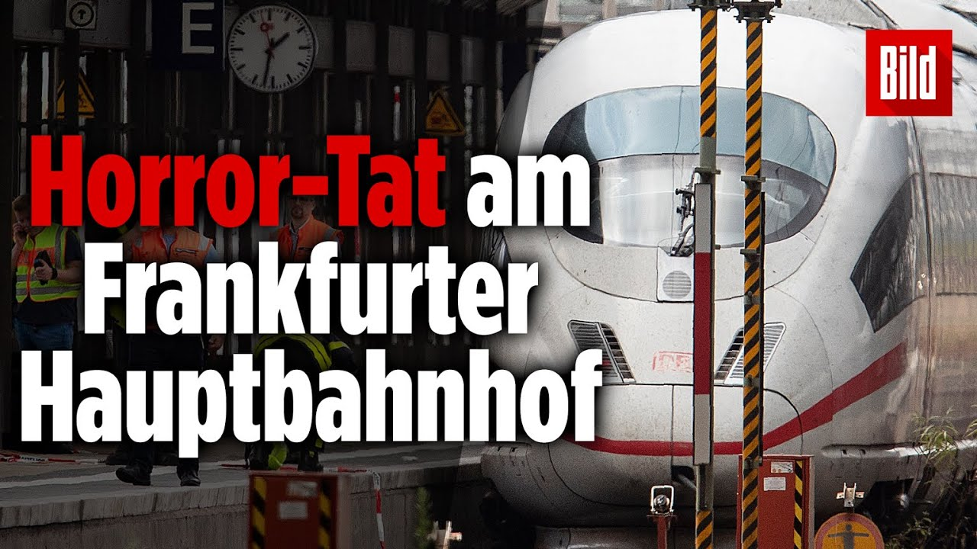
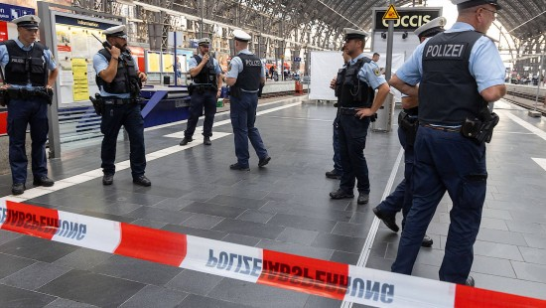
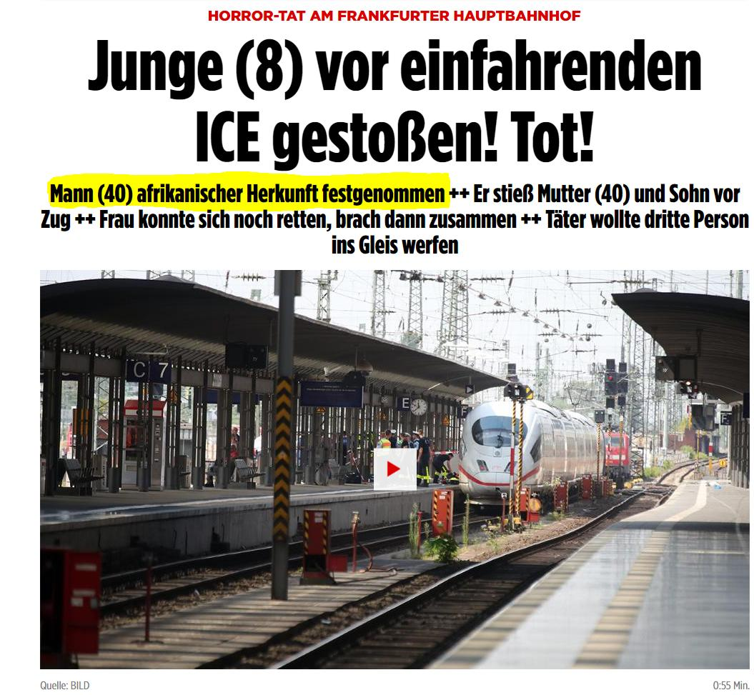
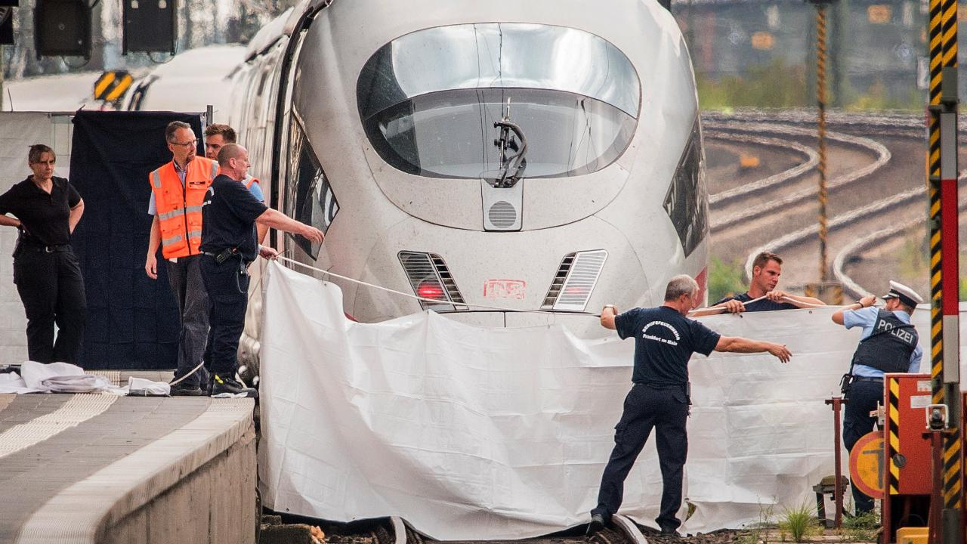
Context

Slide 8
Context
Some numbers and statistics for Germany
~151 deaths per year (accidents)
Over 2600 deaths per year on track (suicide)
8% of all trains do not arrive on time
→ ~1% of all trains are caught up in accidents with humans
Traffic accidents caused by humans and objects cost over 30 billion €
Currently >35.000 km track length across Germany

Slide 9
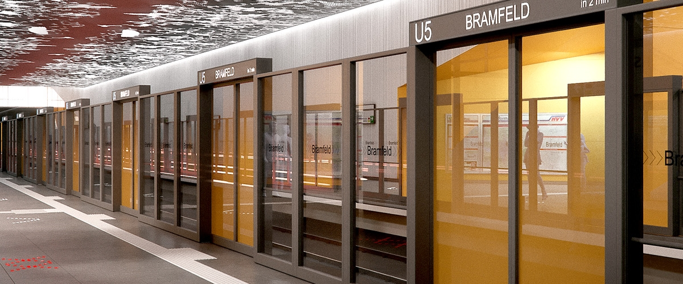
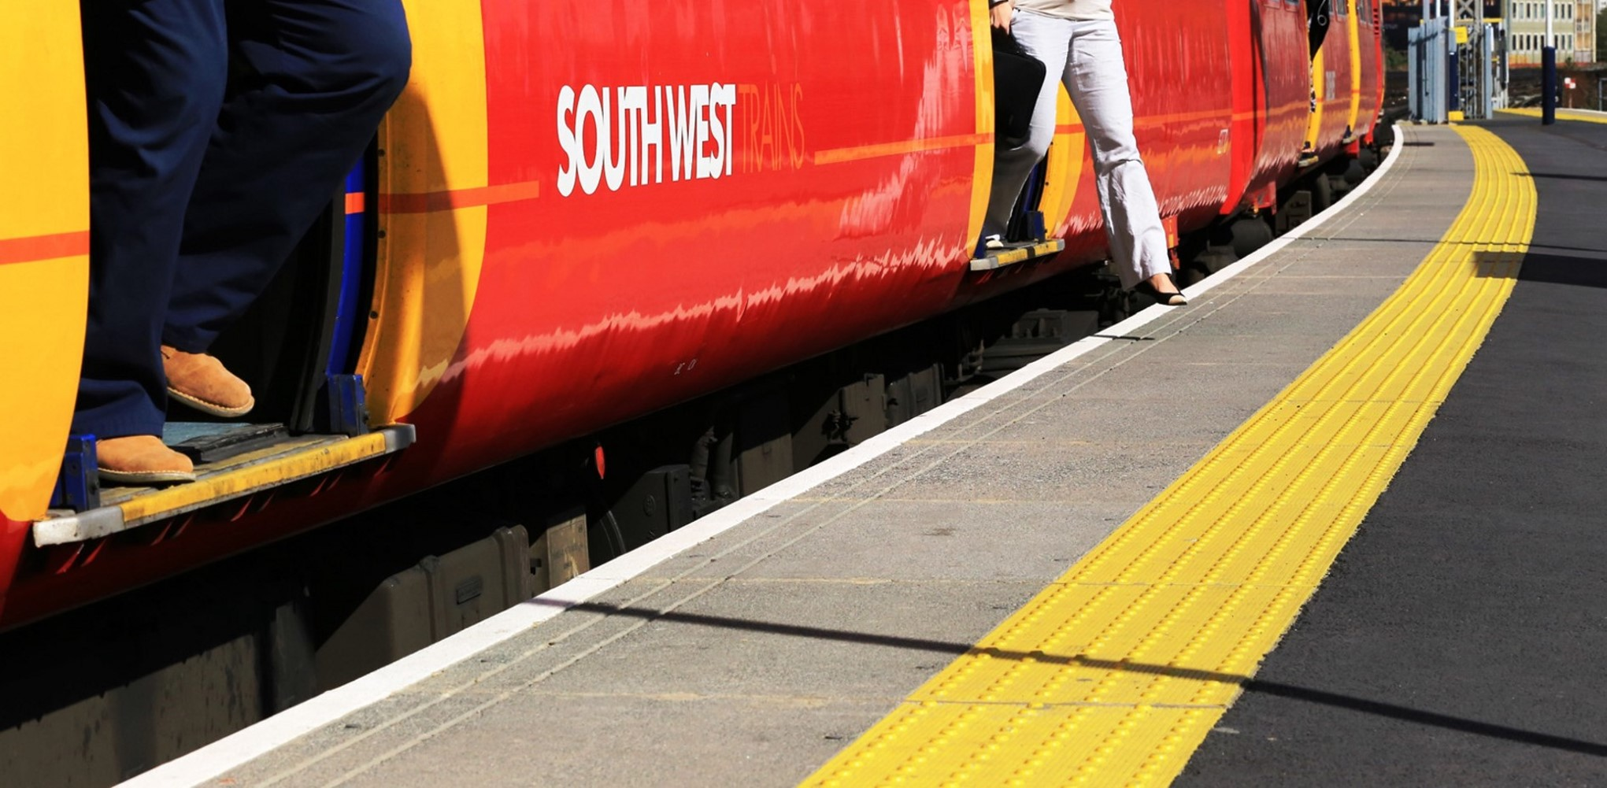
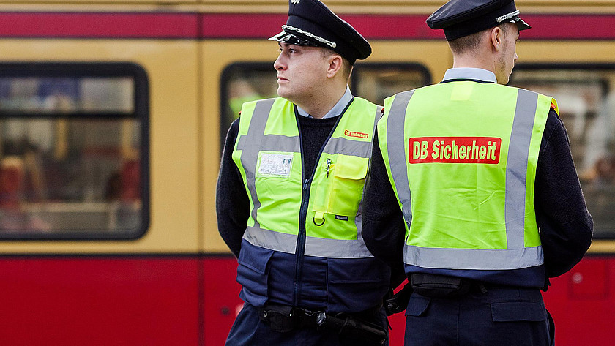
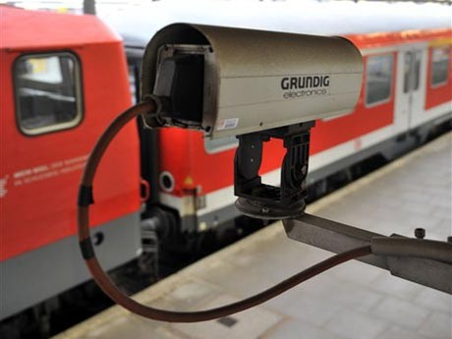
Context

Slide 10
Task
Subway Hazard Detection System
proactive use of existing camera structure
potential danger & absolute danger
too close on tracks
proper reaction
rough location

Slide 11
Performance Requirements
Real-time end-to-end
instant transmission & analysis
detect dangerous situations if they exist
low amount of false alarm

Slide 12
Modeler View
Felix Hoffmann

Slide 13

Overview (Modeler View)
Use available cameras inside train station to take images in regular intervals
Feed images to Neural Network that is trained to identify locations of humans
Use knowledge about position of humans to infer a signal that is sent to conductor of next incoming train
Signal {no action required, slow down, emergency braking}
Train conductor can overrule this decision (our system is only a recommendation system!)

Slide 14
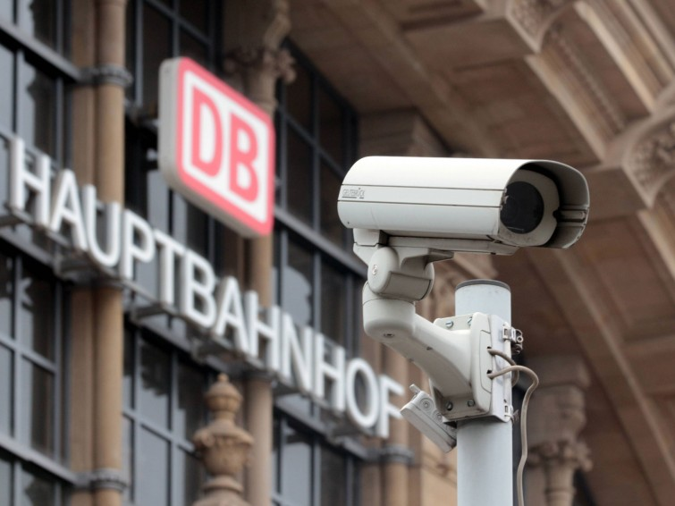
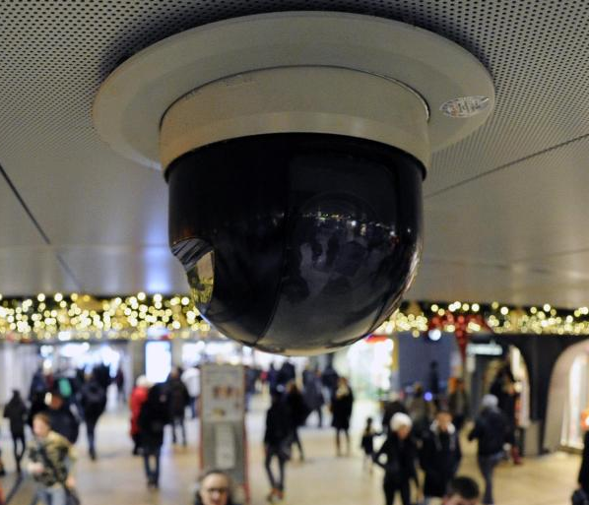
Sensors
Sources: https://www.deutschlandfunk.de/deutsche-bahn-mehr-kameras-an-bahnhoefen.2852.de.html?dram:article_id=306908
https://www.welt.de/politik/deutschland/article112115693/Kameras-in-allen-Bahnhoefen-kosten-Milliarden.html

Slide 15
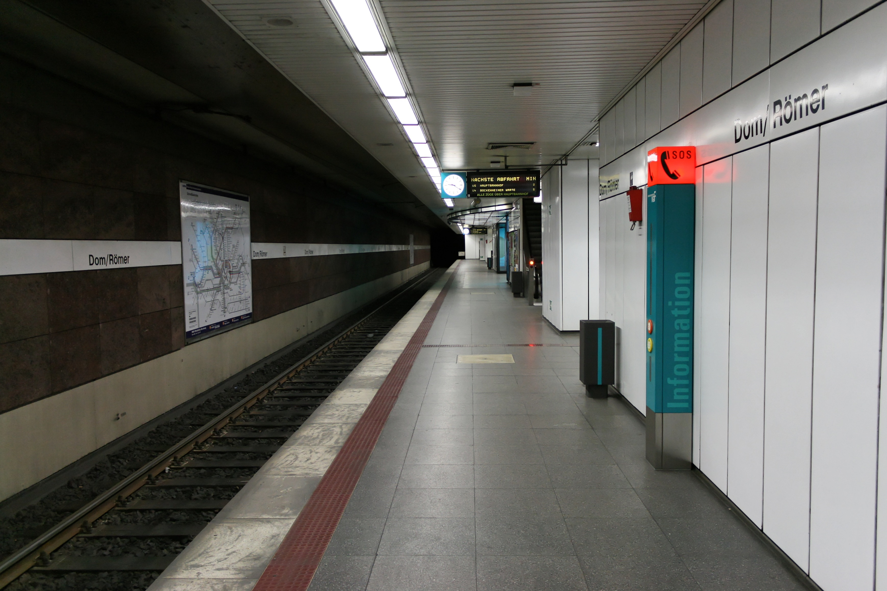
Train station structure – One Track
Source: https://commons.wikimedia.org/wiki/File:U-Bahn-Station_Dom-Römer_(Frankfurt).jpg

Slide 16
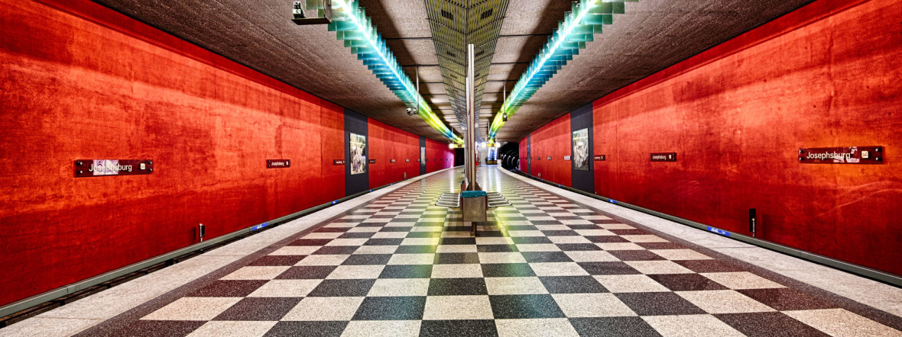
Train station structure – Two Tracks
Source: https://cdn.muenchen-p.de/.imaging/stk/responsive/image980/dms/shutterstock-2019/verkehr/u-bahn-josephsburg-hp/document/u-bahn-josephsburg-hp.jpg

Slide 17
Objects inside train station
We differentiate between fixed and temporary objects.
Fixed objects:
Bench
Ticket machine
Vending machines
Garbage cans
Railway schedule
Destination board / other screens
First aid box
Elevator / Staircases
Cameras
…
Temporary objects:
Humans
Animals
Objects carried by humans
Wheelchair / Walking Aid
Backpack
Suitcase
Smartphone
Bike
Clothes
…

Slide 18
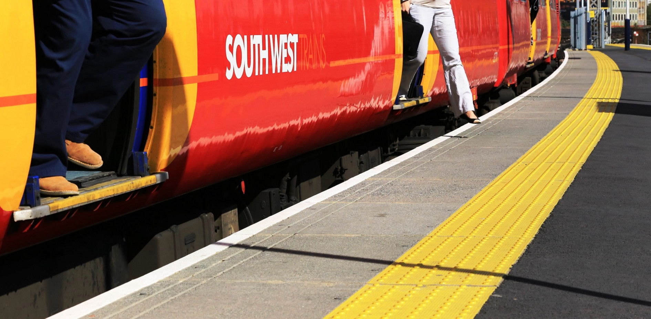
Safety-distance line
Source: https://medium.com/@garethdennis/finding-ways-to-reduce-risk-at-the-platform-train-interface-1d509196ed

Slide 19
Deep Learning Model
Trained on graphical simulations
Model can differentiate between fixed and temporary objects
Automatically detects people in images and their positioning relative to the safety-distances lines
Inference of a danger level that enables a signal {no action required, slow down, emergency braking}
More features in future implementations

Slide 20
Required Features
With a more advanced NN we can take more variables into account when determining a value for our abstract concept of a danger level:
Temporary objects
Wheelchairs
Smartphones
Suitcases
Animals
Especially pets like dogs
Tracking movement over time

Slide 21
Required Features
Training model on more real-world data / more accurate simulations
Increasing robustness to variance
Lighting conditions (influence noise levels in camera images)
Reasoning (e.g. human shown on display attached to the wall is not a real person)
Reflections (e.g. object duplicated in mirror / glass wall)
Occlusion (e.g. human (partially) hidden by another object)
Explainability
Certification

Slide 22
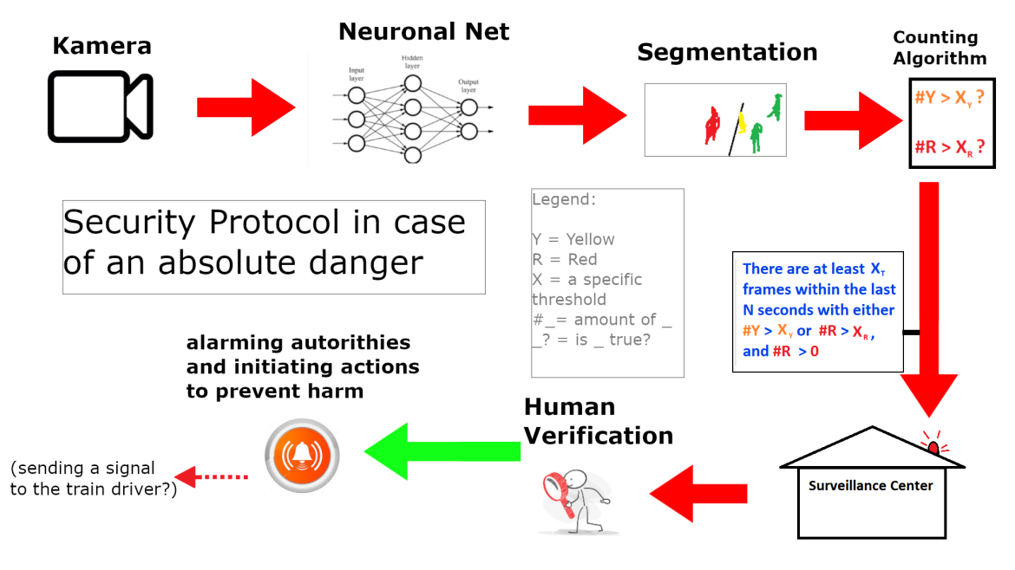
Security Protocol

Slide 23
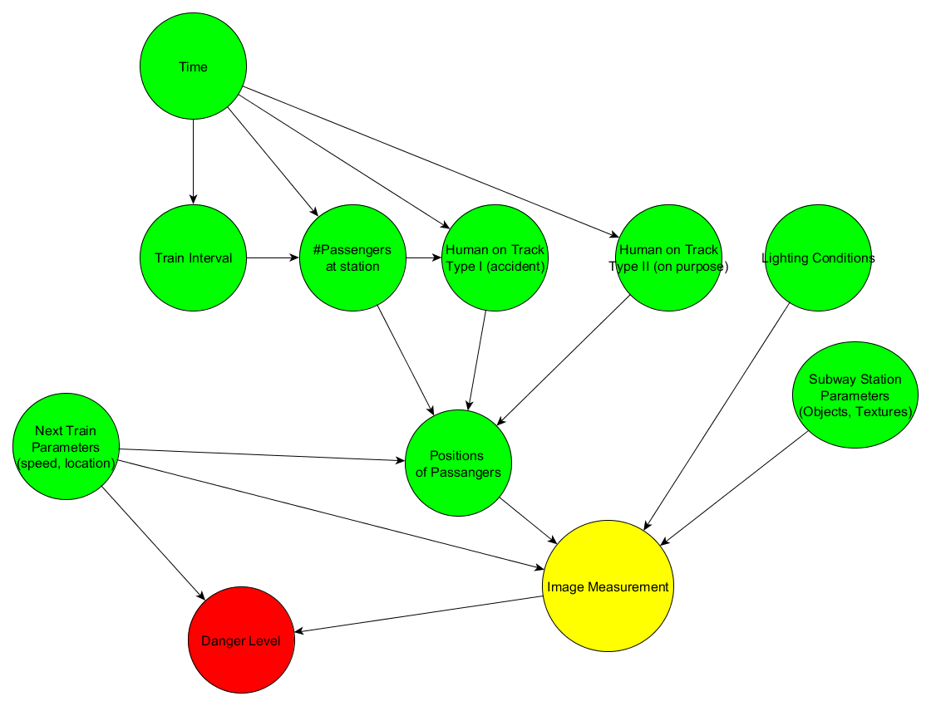
Probabilistic Graphical Model
The distributions can be estimated from real data
Core variables: Humans on Track (two types)
For the first dataset created from simulation a simplified model with hand-estimated distributions was used.
Notes:
A graphical model was designed, with the intention of creating scenes, that are as close as possible to real situations and being simple enough to be able to possibly approximate the underlying distributions from real data, if desired.
For brevity, i will only consider the core variables.
We identified two types of humans on the track: Accidents and on Purpose.
This is important, as an accident usually means, that it is independent from the position of the next incoming train, while a person that is on the track on purpose will do so based on the train position (e.g. for spraying a graffity or a suicide attempt)
If someone throws himself in front of a train on purpose, there is not much we can do at the moment.
For a future implementation it might be useful to separate the two types, as one might be easier to predict, than the other.
For the first dataset created from the simulation, we handestimated distributions for an slightly simplified model. The estimations are based on in our eyes reasonable assumptions.

Slide 24
System Implementation View
Pascal Fischer & Alen Smajic

Slide 25

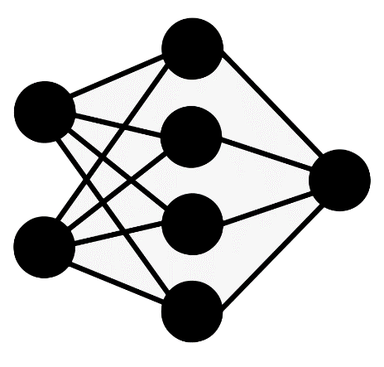

System Modules
The simulation, which can generate various realistic scenarios of a subway station
The learning algorithm, which can classify the danger level based on the current situation
The security protocol, which processes the outputs from the learning algorithm and initiates appropriate process steps to ensure the security of the station
Learning Phase
Handover to Service
Simulation
Learning Algorithm
Security Protocol
Training/Validation data
Pixelwise Danger Level Classification

Slide 26








Implementation Tasks
Implementation of the first prototype
1. Development and procurement of 3D station assets
2. Implementation of the simulation
3. Integration of the „distribution of characters“ inside the simulation
4. Development of the learning algorithm for pixelwise classification
5. Implementation of the security protocol
External Resources:
External Resources:
Free3D

Slide 27
The Dependency of the System Modules
Deep learning approach to classify the danger level (semantic segmentation)
We use semantic segmentation to recognize and classify people into one of the 3 categories: green, yellow or red
Depending on the classification, a corresponding security protocol decides how to deal with the respective situation and triggers a corresponding security process
Learning Phase
Handover to Service
Simulation
Learning Algorithm
Security Protocol
Training/Validation data
Pixelwise Danger Level Classification

Slide 28
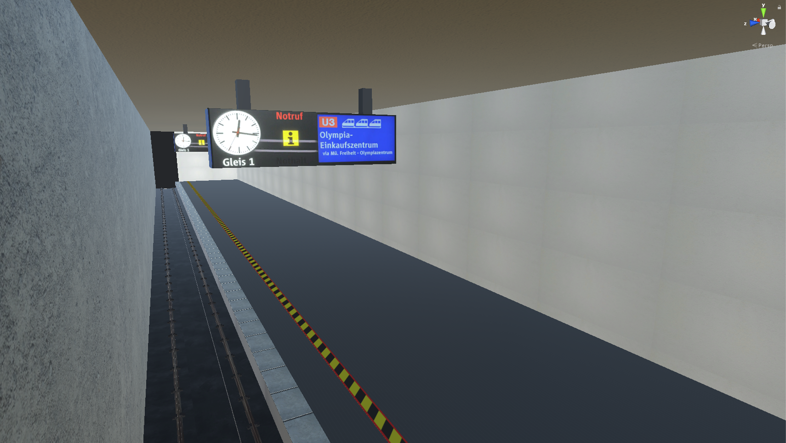
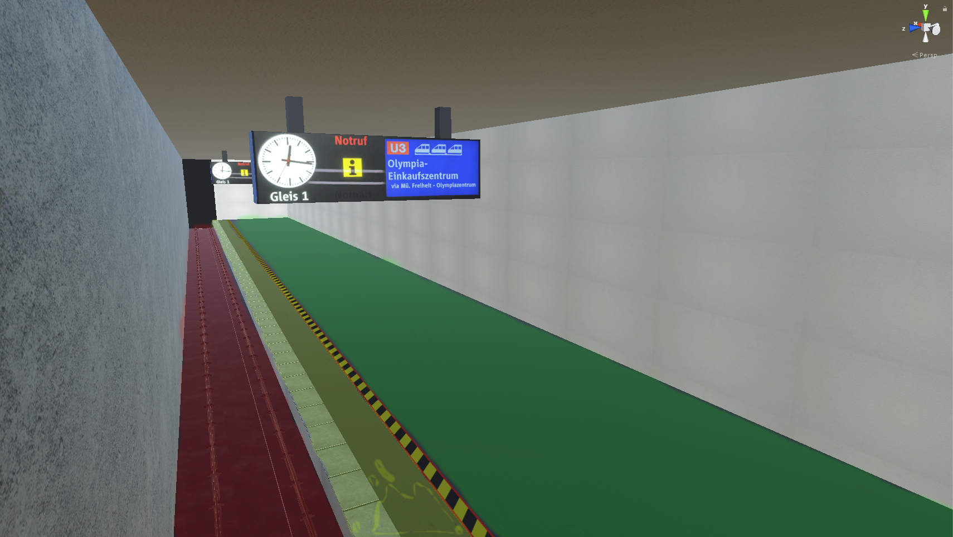
Danger Level Overview
Floor marking on each subway platform (1.5m from the edge of the platform)
Safe
Dangerous
Potentially Dangerous

Slide 29
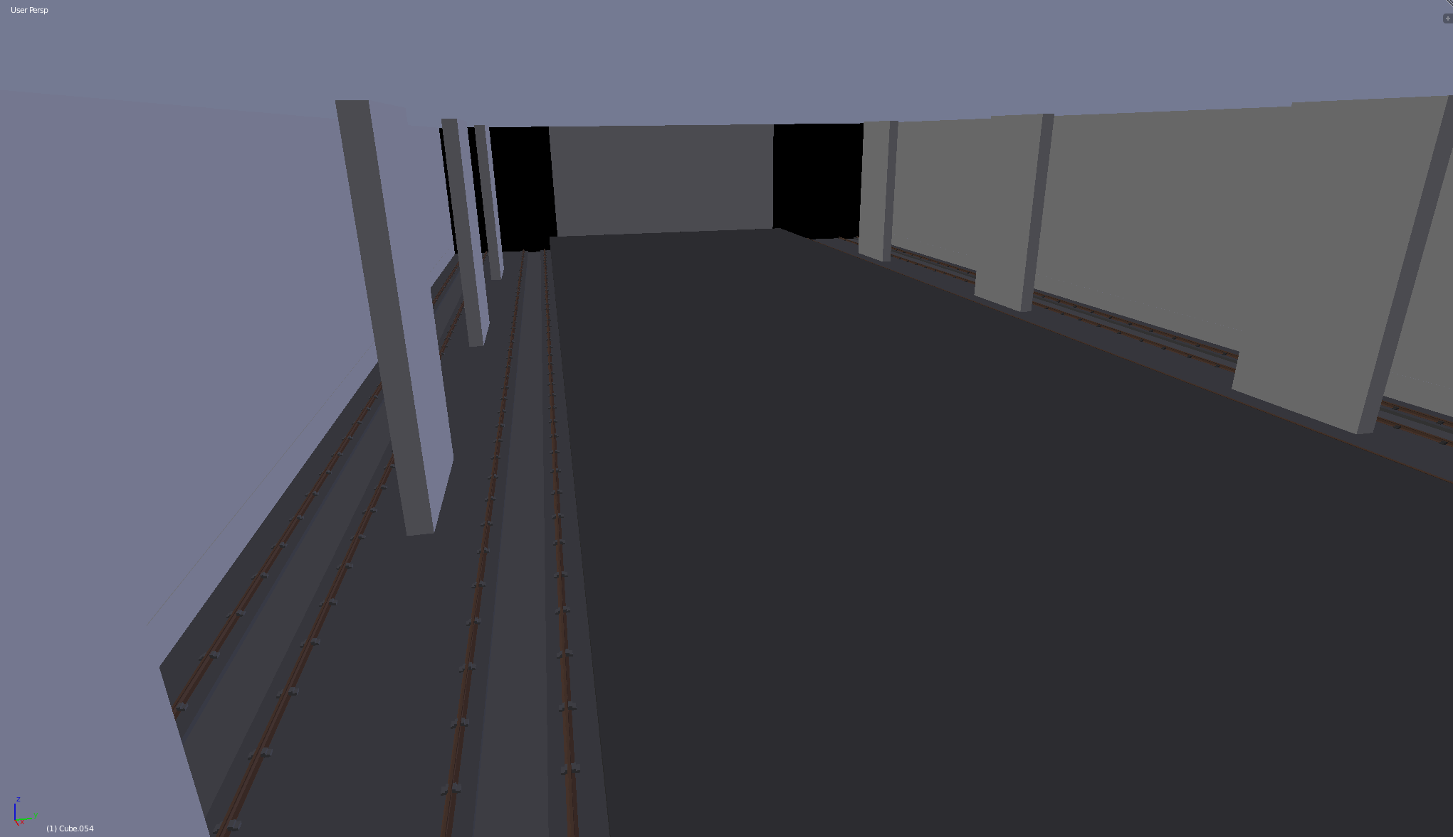
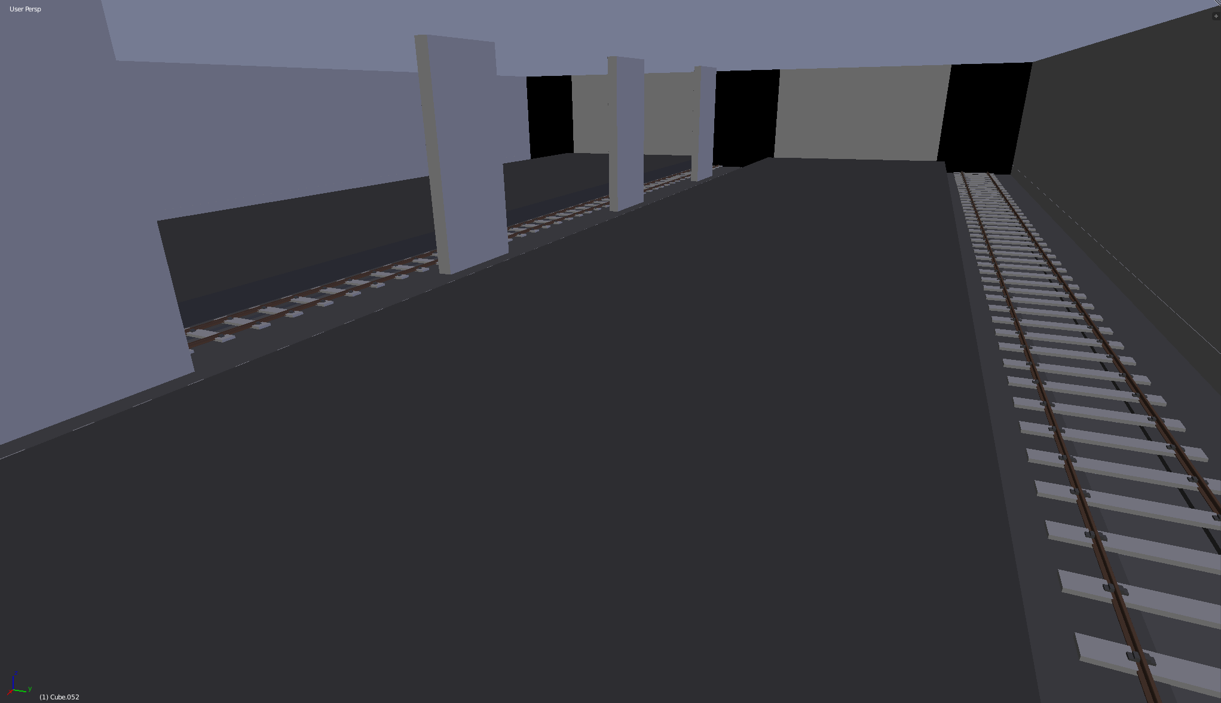
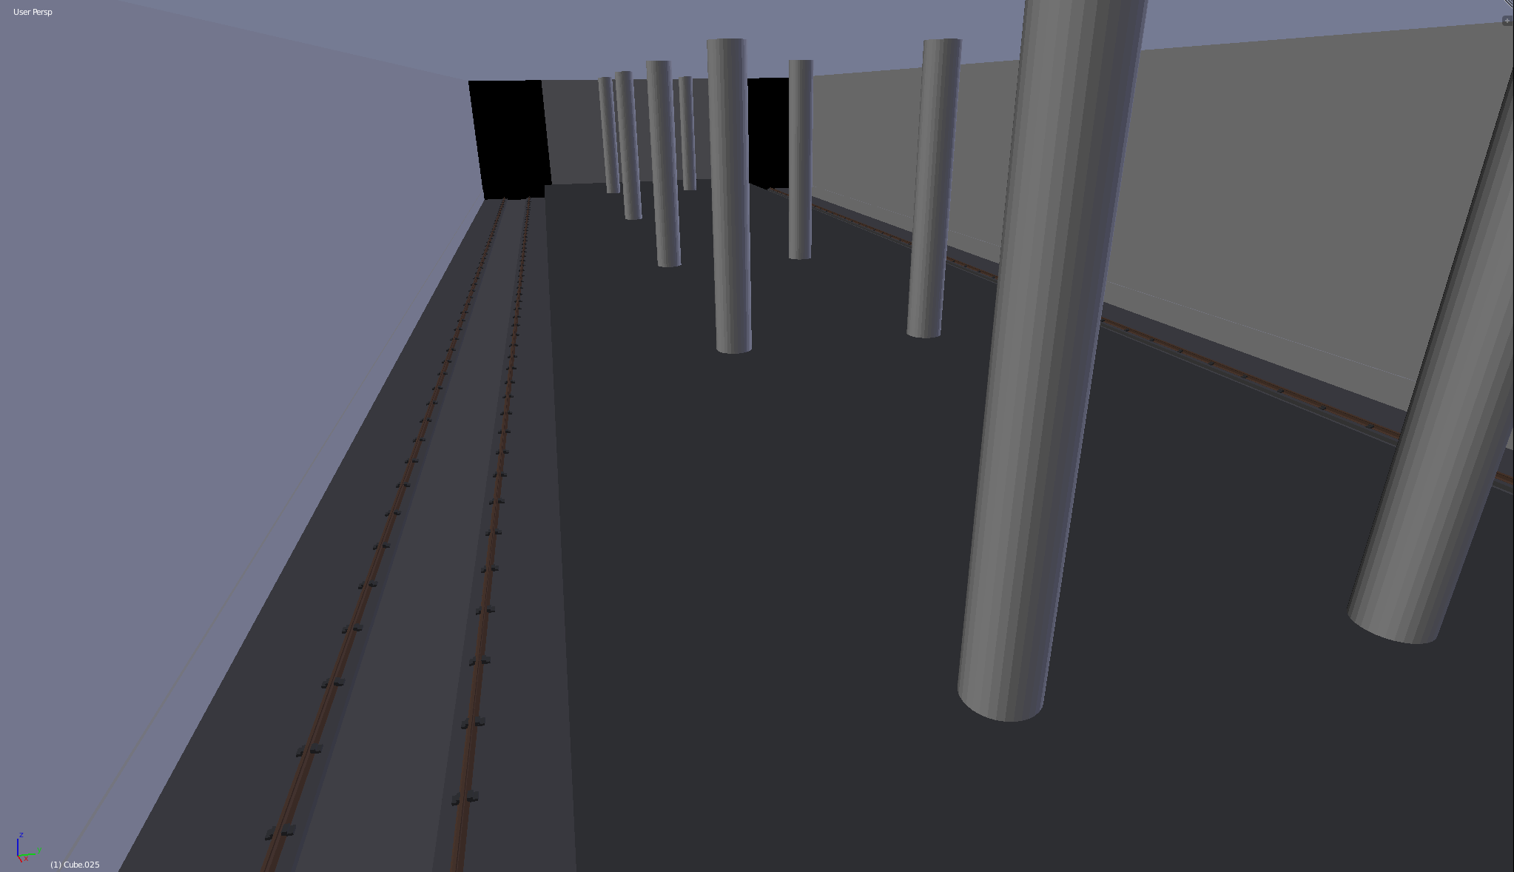
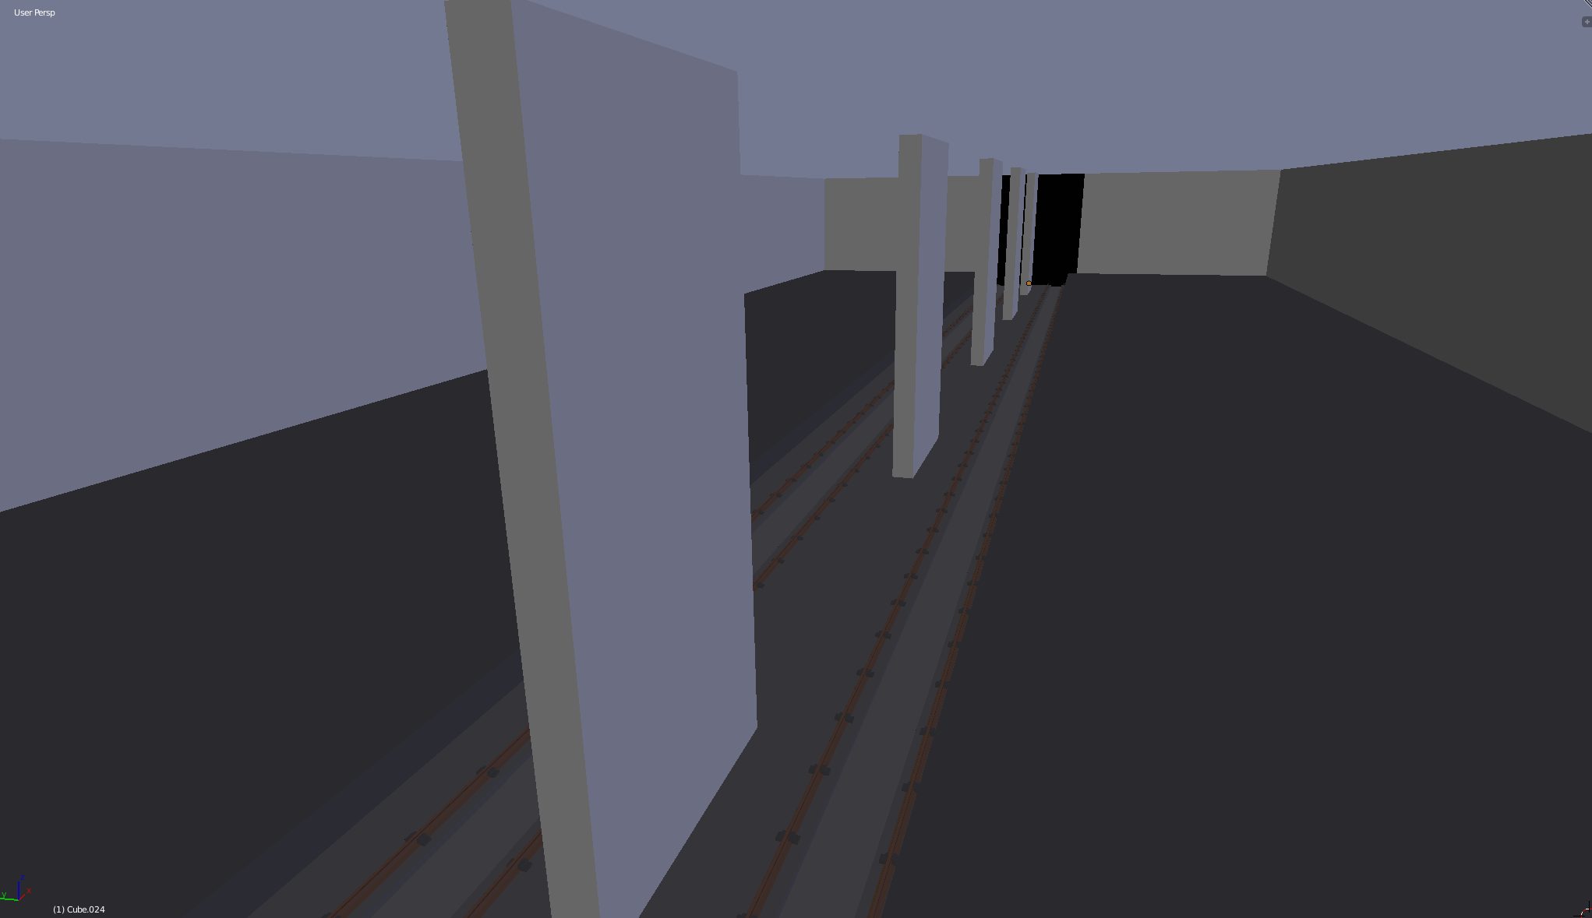
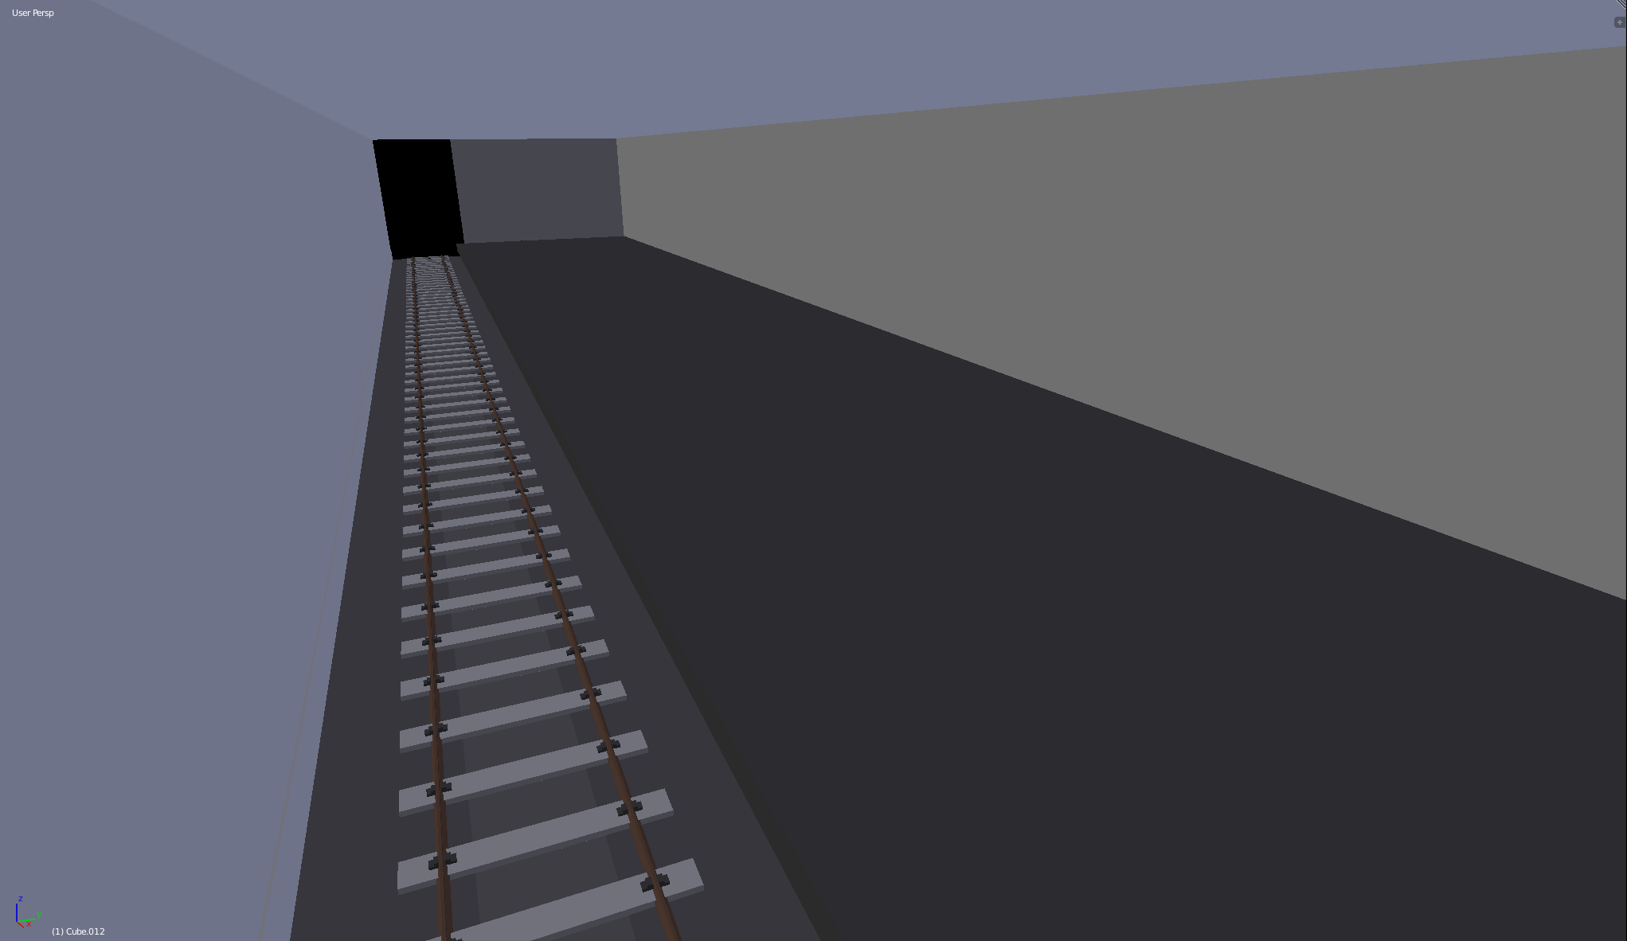
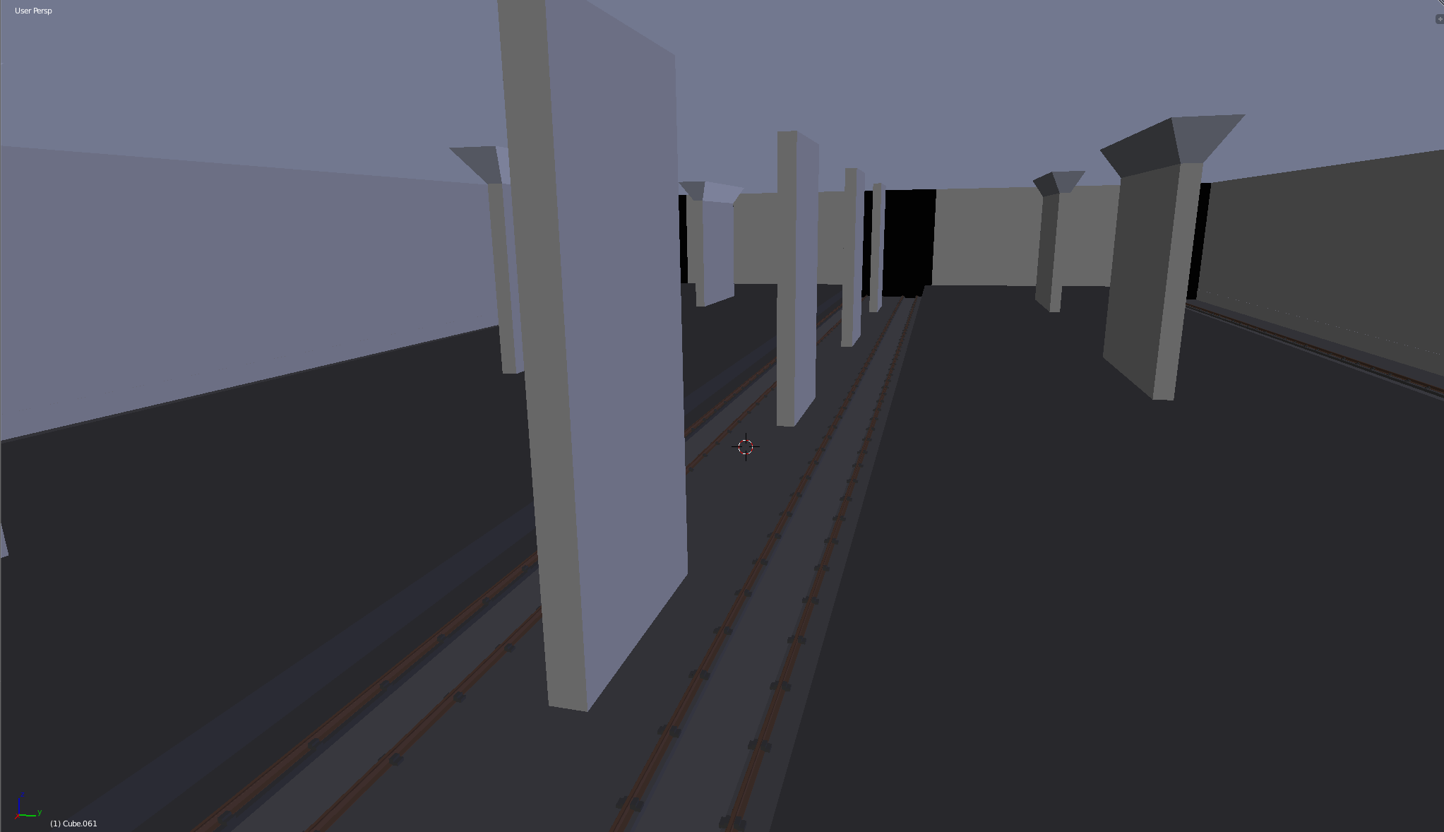
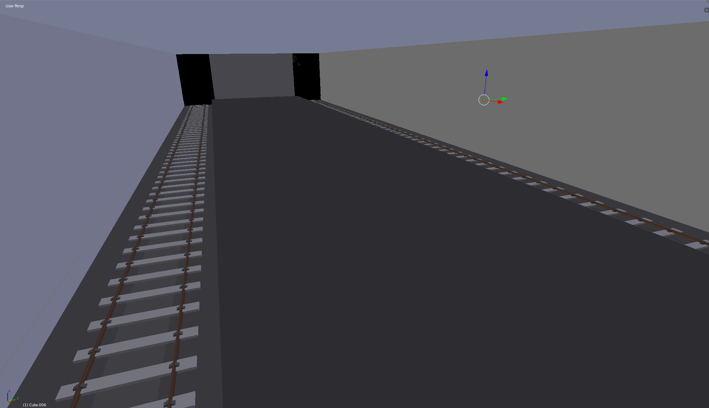
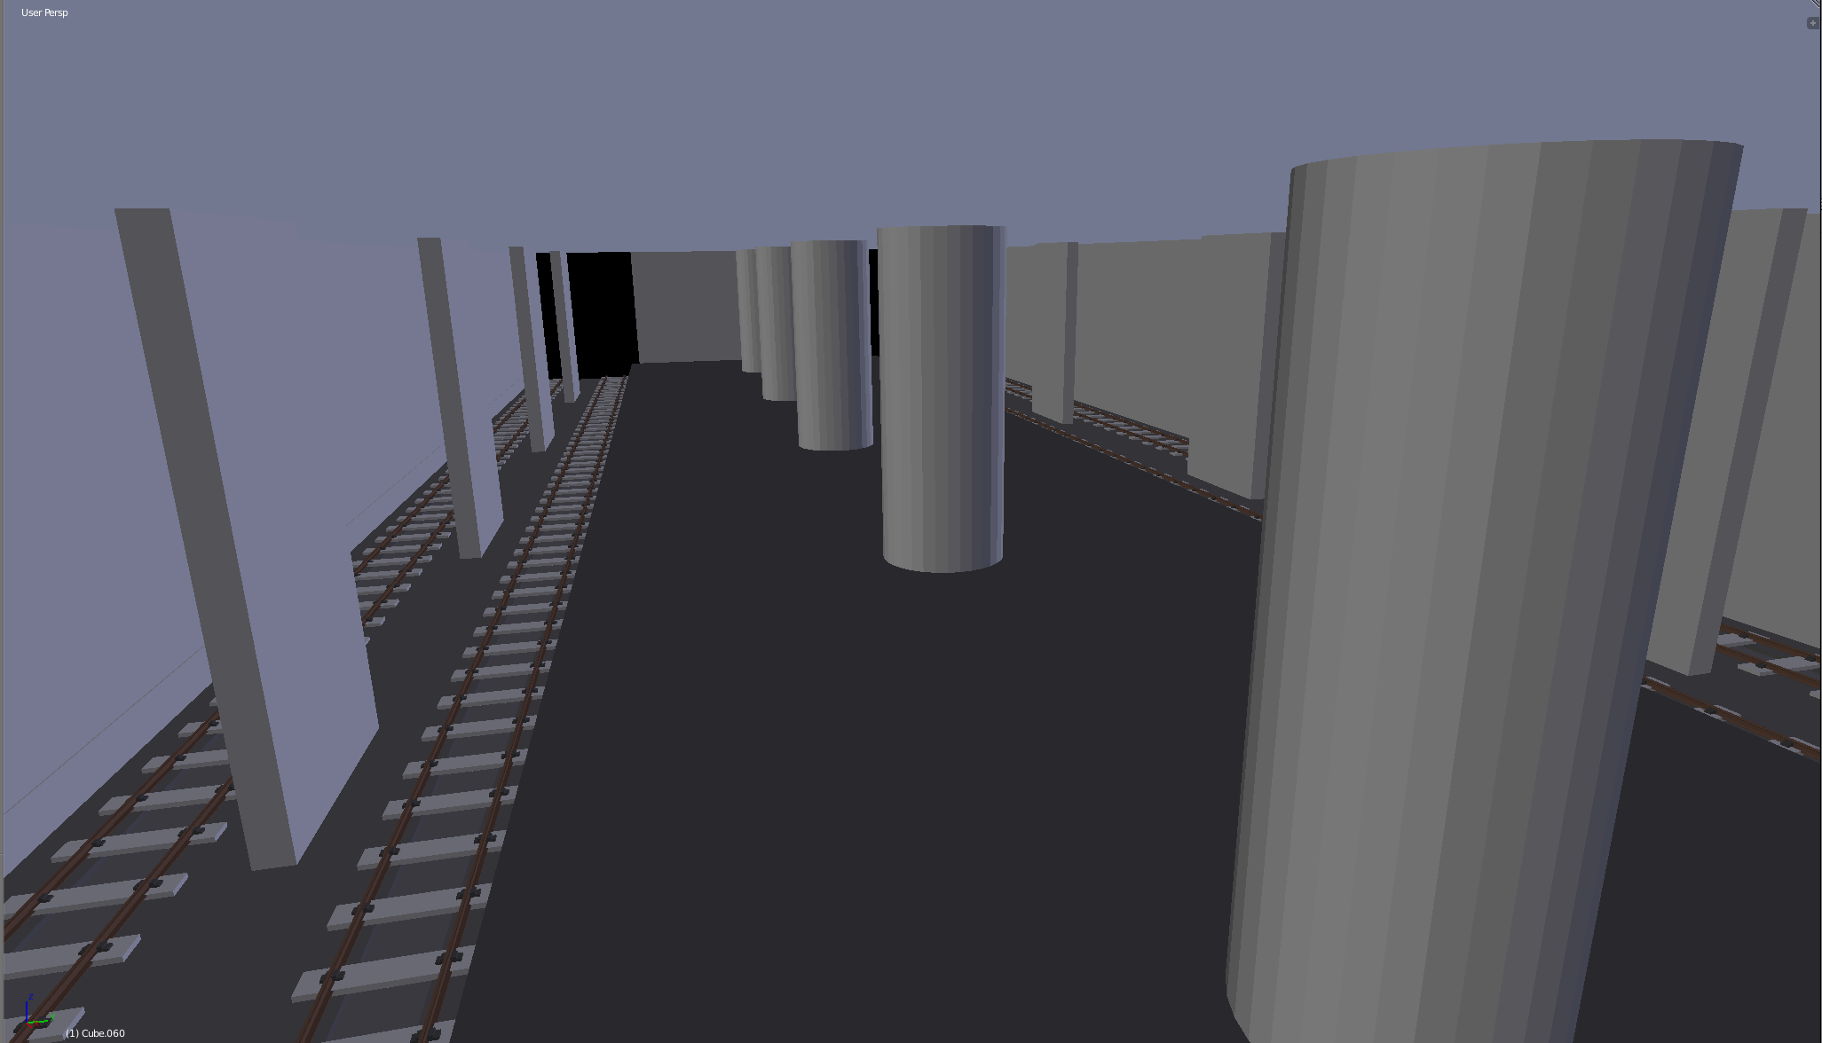
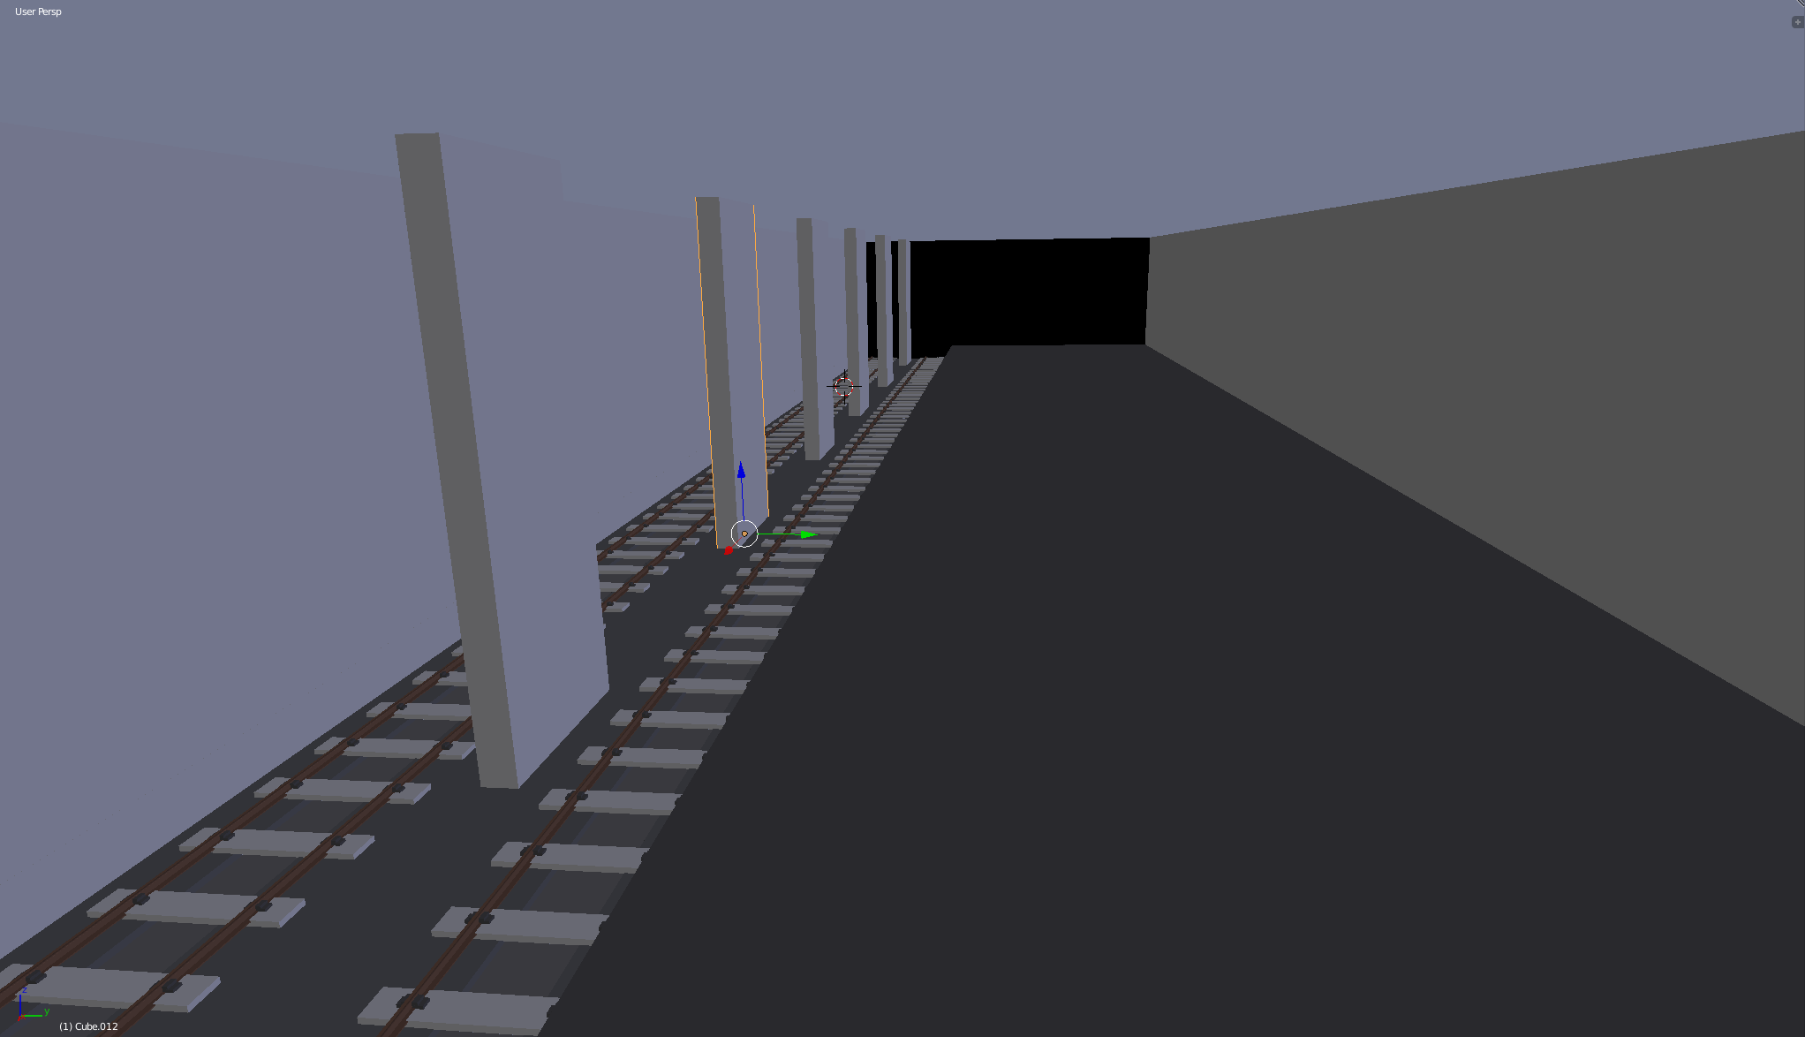
1. Development of 3D Station Assets
Station models
Station objects
Human models
Textures
10 different station types

Slide 30
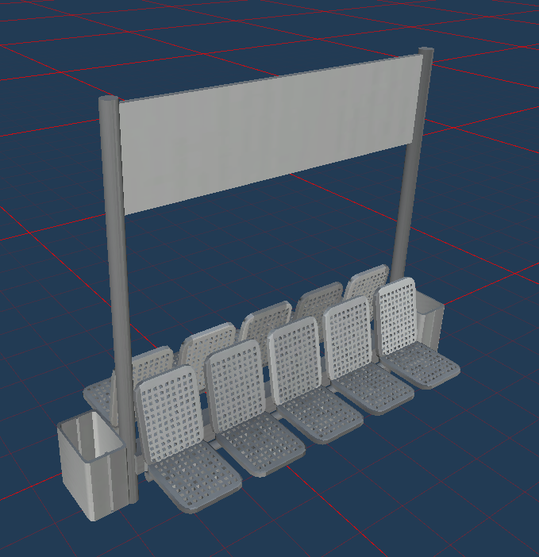
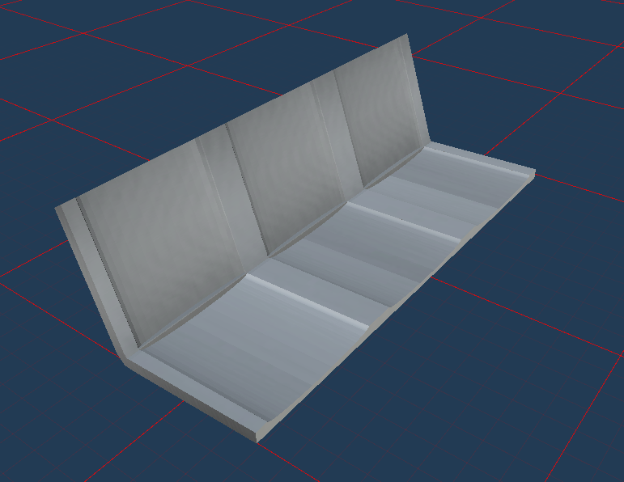
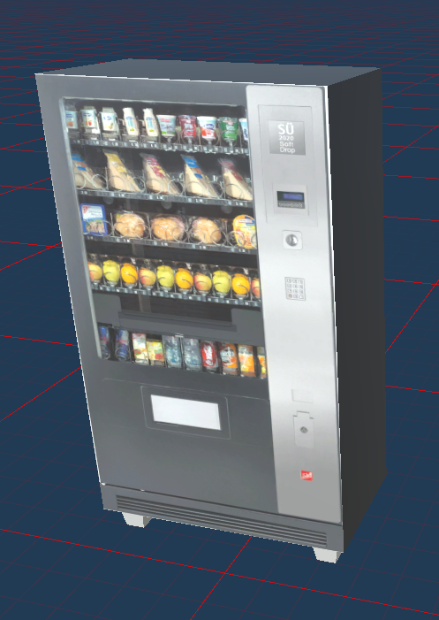
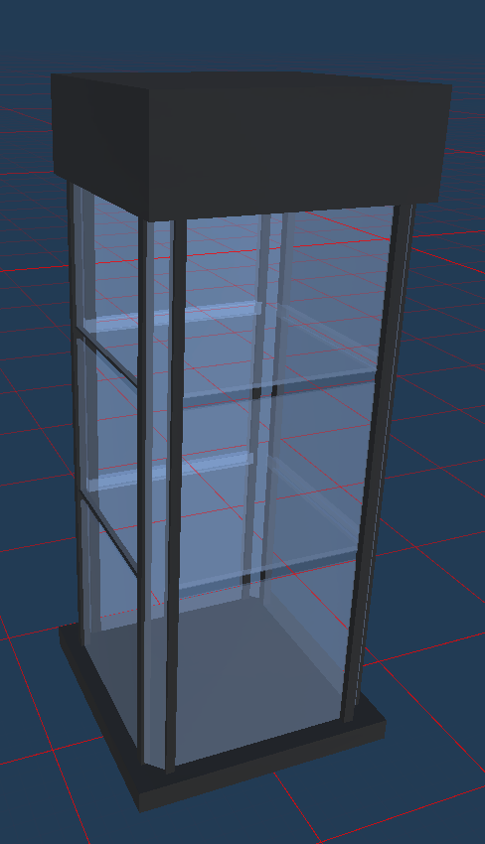
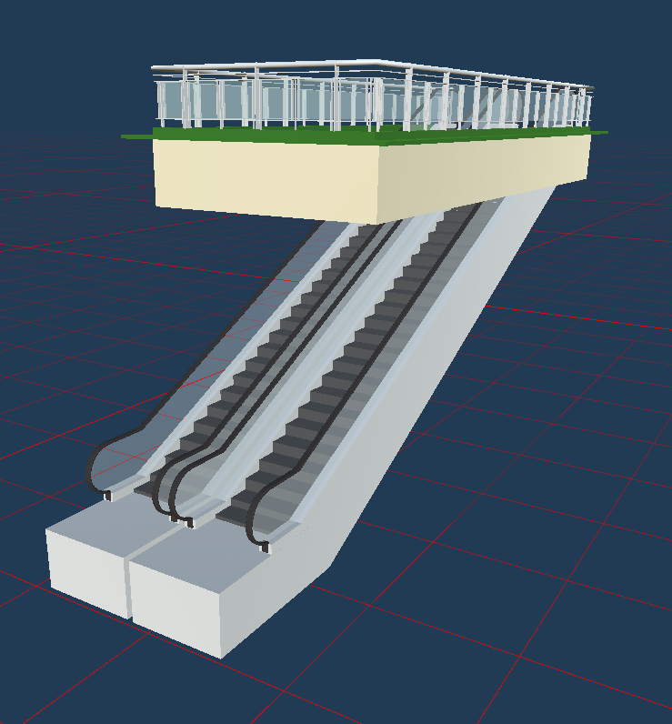
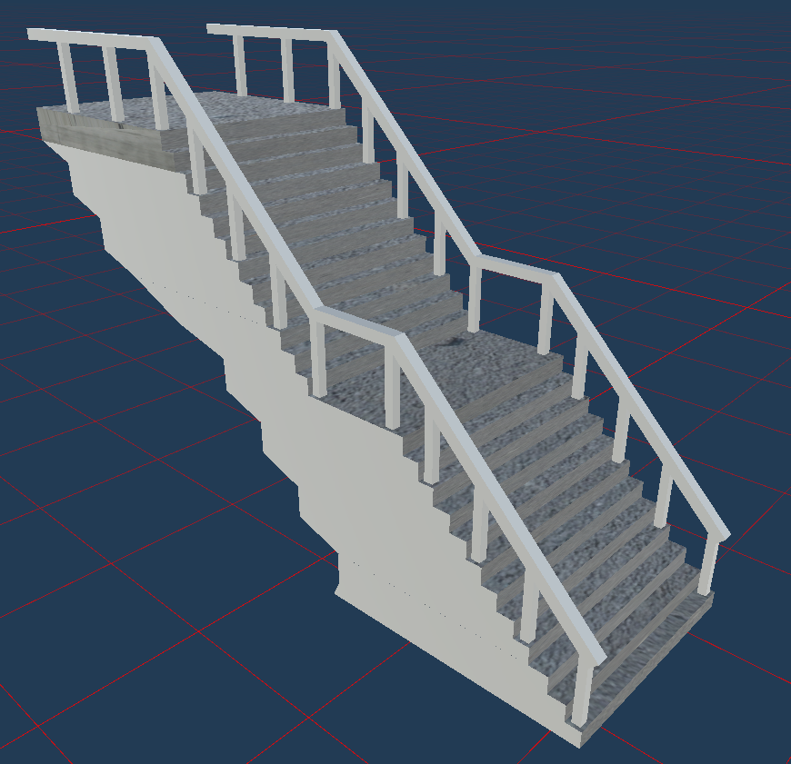
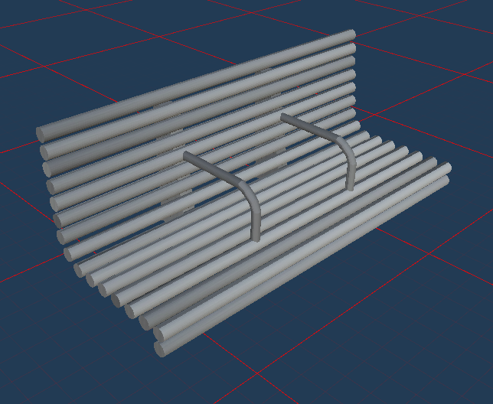
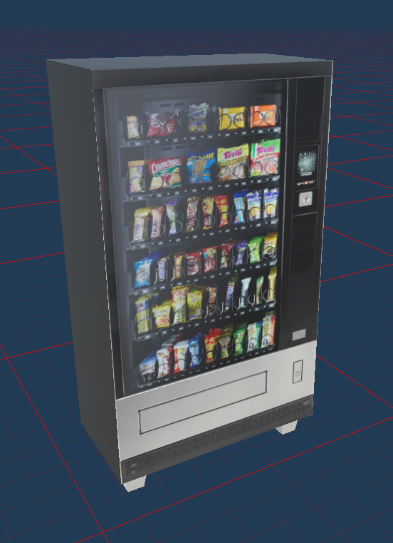
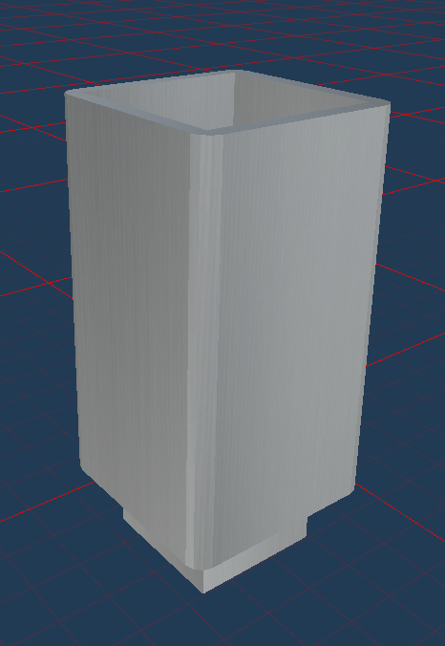
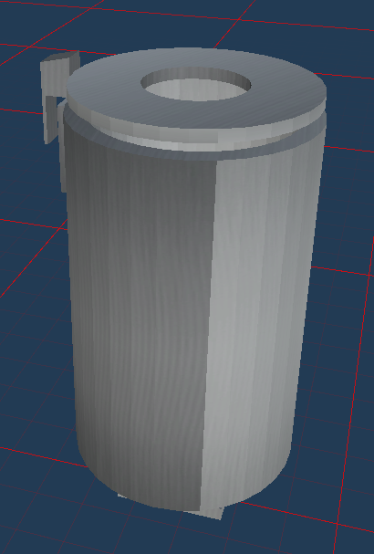
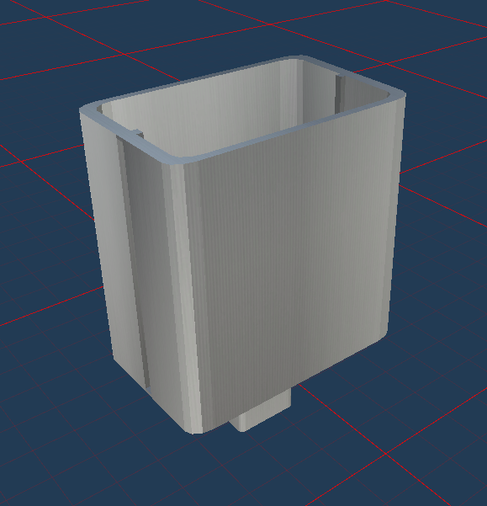
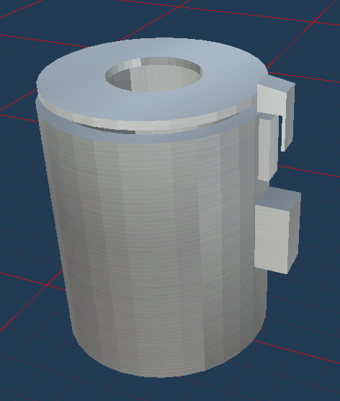
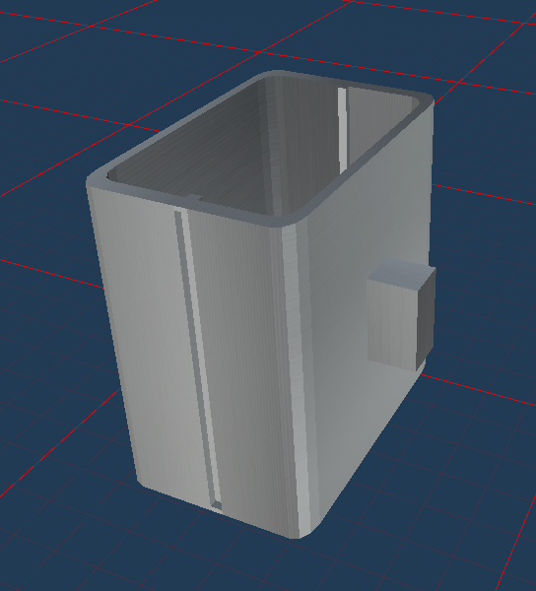
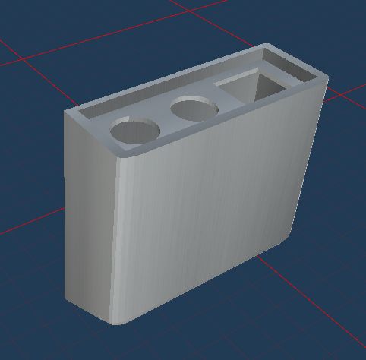
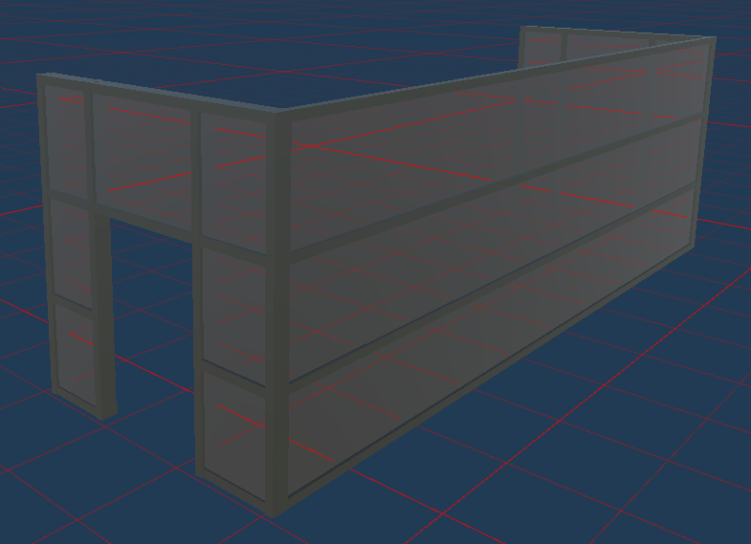




1. Development of 3D Station Assets
Station models
Station objects
Human models
Textures
Rubbish bins, chairs and benches, Elevators, Escalators, Snack machines, stairs, Entrances, Departure boards

Slide 31





1. Development of 3D Station Assets
Station models
Station objects
Human models
Textures
25 different characters

Slide 32

1. Development of 3D Station Assets
Station models
Station objects
Human models
Textures
119 different texture packs

Slide 33




2. Subway Station Simulator
Generates realistic station scenarios and the corresponding ground truth images
These images are used as training, test and validation data for the learning algorithm
Semantic segmentation to classify every pixel into one of 5 classes: white, black, green,
yellow or red

Slide 34
2. Subway Station Simulator
Simulator Specifications:
Constant lighting without any shadows or reflections
Camera recording without any occurence of noise
Recordings from both endpoints of a station
Cameras are positioned on the ceiling at an angle of 30° and cover the space between the tracks and the station platform
Images are recorded in 1080p resolution

Slide 35








2. Subway Station Simulator
Simulator Specifications:
5 unique designs for every station type resulting in a total of 50 unique subway station environments

Slide 36


2. Subway Station Simulator
Simulator Configurations:

Slide 37
Generating random normal distributed numbers
Unity, C# supports only uniform distributed numbers
Box Muller method to slow
Using slightly different method: Marsaglia polar method

Slide 38


Generating random normal distributed numbers
Step1: Generating

Slide 39


Generating random normal distributed numbers
Step2: Transform

Slide 40

Generating random normal distributed numbers
Step2: Prevent random numbers outside a given range [min, max]

Slide 41
Character Distribution - Pascal
Number of characters in a scene = Uniform({0, 1 , 2, … , 79, 80, 100, 200, 300})
Place every character on the platform in general
Add additional character on the tracks with probability 1/200
Required distribution: Two different types of characters on the tracks
Probability type 1 (accident) = 1/309600, and type 2 (on purpose) = 1/3600
To obtain correlation with people on the tracks: Probability character on the tracks: 1/10000

Slide 42
Character Distribution
Three states for characters on the platform
Sitting
Standing
Walking
We don‘t make a difference between walking and standing
Probability standing = 2/3
Probability sitting = 1/3
If is no seat available then every character will be standing

Slide 43
Character Distribution
y-rotation angle = Uniform({1, 2, … , 360})
x-rotation angle = 0 (90 degrees to the platform)

Slide 44

Character Distribution
x-position on platform = RandomNormal(center, width/4, end1, end2)
center = x coordinate of platforms center
width = platform length on x-axis
end1 = center – width
end2 = center + width

Slide 45
Character Distribution
y-position on platform/tracks = Uniform({0, … , platform_length})
X-position on tracks = Uniform({0, …, platform_width})
y-position and rotation for character on a seat is uniform distributed over all seats

Slide 46

Subway Station Segmentation
Classify each pixel of an image to one of the 5 classes
white – background
black - security line
green - character in save area
yellow - character near the dangerous area
red - character in the dangerous area

Slide 47


Subway Station Segmentation
Network Architecture

Slide 48

Subway Station Segmentation
Loss Function: Categorical Weighted Cross Entropie Loss
Classes = {white, black, green, red, yellow}
Class ∈ Classes is the correct class for x

Slide 49

Subway Station Segmentation
Loss Function: Weights
pixel(class) = |{p ∈ img | pred(p) = class | img ∈ T}|
Multiply weight for white class with 10 to get a higher precision

Slide 50
Subway Station Segmentation
Training
Training (50.000 imgs) and validation (10.000 imgs) dataset
75 Epochs of training on training dataset
Nvidia Volta GPU from AI Lab
Stochastic Gradient Desent

Slide 51


Subway Station Segmentation
Results: Evaluation

Slide 52

Subway Station Segmentation
Results: Example One
Image Ground Truth Prediction

Slide 53

Subway Station Segmentation
Results: Example Two
Image Ground Truth Prediction

Slide 54

Subway Station Segmentation
Results: Example Three
Image Ground Truth Prediction

Slide 55
Thresholding Algorithm
Input: Segmentation output for both Images, Threshold
Count number of red (yellow) pixels in predicted output
If the number is greater than the specified threshold, a situation is classified as dangerous (potentially dangerous)
Notes:
In order to reach a final decision based on the segmentation output, we used a simple threshold method. Note, that for each scene, there are always two images from different angles on the scene. This means, that an unoccluded object has approximately the same amount of combined pixels in both images, regardless of the exact position. Therefore a relatively low threshold should be able to lower the amount of false-alarms, while maintaining a good detection rate of dangerous situations.

Slide 56
Validation View
Martin Ludwig, Edis Kurtanovic

Slide 57

Segmentation Output Examples I
Samples for Validation set are drawn from same distribution as training set.
≅ 43% of samples show red in the ground truth (much higher, than in reality)
Segmentation output is in general quite good, but blurry edges
Input Ground Truth Output
Notes:
For the Validation set, 10.000 samples were drawn from the same distribution, as training set.
Around 43% of the samples have at least one red pixel in the ground truth and are therefore considered as dangerous.
We see, that the segmentation output on these examples is quite good, but the edges are rather blurry.

Slide 58

Segmentation output examples II
≅ 57% of samples contain no red in Ground Truth
Output often contains small red artifacts
→Threshold-Procedure to decrease False-Positives (=False Alarms)
Input Ground Truth Output
Notes:
Now we take a look at some samples, that don‘t contain any red pixels in the ground truth.
We see, that the segmentation output often yields some small artifacts, as an outstretched hand can be viewed as over the tracks.
Based on these observations, we decided to implement a threshold-procedure, where we only accept outputs, that have more red pixels than a certain threshold as dangerous.

Slide 59


Validation - Validation Set
Notes:
The plot to the left shows accuracy against the threshold. Highest accuracy is achieved with a threshold of around 100-200 pixels
Maximal accuracy will probably lead to a lot of cases, where dangerous situations are not detected. To view this trade-off, we plottet a Receiver Operator Curve. The TP-rate is how many of the dangerous situations were correctly classified, while the FP-rate is in our case the false-alarm rate, that is, the system deems the situation dangerous, even though it isn‘t.

Slide 60


Validation - Validation Set
Notes:
For the yellow class, we see the validation results are a lot better. With a low threshold, the TPR is over 80%, while the FPR is below 20 %. This is still far from the requirements for final implementation.

Slide 61





Validation using real data
How well do models trained in simulations generalize to reality?
Expectations like those in the Performance Requirements:
amount existing dangers detected, amount false alarms
ideally results as good as previous results which used simulated data
Idea:
Camera recording → extracted frames → prototype → output → analysis
+?
Notes:
1.) A general question asked when working with AI and simulations is how well do those models trained in simulations generalize to reality. This also applied to us and we kept wondering the same.
2.) As for the expectations, they are the same as the ones explained in the User View: We want the prototype to detect dangers if they exist and we do not want many false alarms. But we are aware of the fact that such systems generally perform worse in real data sets than in simulation data sets.
3.) The general first idea we had is the following: We take a recording done by a surveillance camera in a subway station, extract the frame from it and feed them into our prototype. The outputs of the prototype are then to be analyzed. It shall be noted however, that (as you will see soon) there were actually more steps required to achieve results we could work with.

Slide 62
Validation using real data – Searching for good camera recordings
Looking for:
underground station
similar point of view
humans across the scene
good enough quality to recognize things
Very hard to find such videos!
Chosen video: “Koelner Schubser” (2018)
Notes:
1.) As you recall, I mentioned that we first had to find a suitable video which we could then use for our evaluation. The video had to be taken from a similar perspective as the perspectives we used in our trainings in underground stations, and it had to feature human beings across all zones (green, yellow, red). The quality of the video has to be acceptable.
2.) In the wake of these requirements, it was very hard to find such videos. Most videos we considered had problems with quality or were showing a very different type of station we feared might not work well with our prototype. After a long discussion and audition, we chose to use a video taken two years ago by a surveillance camera in an underground station in Cologne.

Slide 63

Validation using real data – The chosen video (“Koelner Schubser”)
Notes:
This is a quick video runthrough. The video starts with people walking across the station. Later however, the young person with the white t-shirt intentionally pushes a stranger onto the tracks.

Slide 64








Validation using real data – Extracting Frames
77 interesting frames
Notes:
We extracted one frame for each second into the video. You can see a bunch of them here.

Slide 65

Notes:
Here you can see a zoomed in version of one of the frames (Frame 59).

Slide 66

Validation using real data – First results
Notes:
Here is what happens if we put last picture into our system. This is the output we get. ICH BRAUCHE NOCH EIN BILD, AAAAAAH.

Slide 67

Validation using real data – First results
Notes:
For comparison, on the left you can see how input generated from our simulation tool looks like.
Now, ignoring the slightly different perspective and the different station architecture, we notice a few major difficulties: First up, there are very strong reflections from both the platform and the wall on the real picture. Next up, heads and faces are censored. This is required by German law; else this camera recording would have been allowed to be broadcast. After the surveillance camera recording got made available to the public by the NRW police, Russia Today picked it up and uploaded it on Youtube. That’s why you can see both Russia Today’s and the NRW police’s logos on the left side.

Slide 68

Validation using real data – There is no warning line!
Notes:
1.) Those of you who paid attention during Alen’s & Pascal’s speech might have noticed, but I left out one important difference: there is no black-and-yellow warning line in this video. Actually, there probably does not exist any video on this entire world that features such a line.
2.) Here, this picture is the picture again from last slide, so you confirm this detail.

Slide 69








Validation using real data – There is no warning line!
Solution: Manually add the line to each frame.
Notes:
We found a solution to this problem. Since there was no quick workaround, we had to edit each frame manually to contain such lines. (I didn’t expect this lecture would teach me how to use GIMP.)

Slide 70

Notes:
Here you can see one edited frame zoomed in. Embedding the line perfectly was not possible due to the varying illumination or reflection in the original scene.

Slide 71

Validation using real data – First results
Required line got added
now we can start!
Notes:
1.) Now that we have added the required line, we can start feeding all these frames to the prototype.
2.) We can now put pictures like this into our system (this is the picture from the last slide).

Slide 72
Validation using real data – Judging first results
Good detection of existing warning line
Unsatisfying detection of actual danger
Unsatisfying amount of colored fragments
Unsatisfying categorizing (colors of detected people)
Notes:
As you could see, there was a bunch of things that is problematic for a good Subway Hazard Detection System. The system struggles to detect actual danger, which was a very important task, and it colors those people it does detect wrongly. There were also a lot of clumps of color spread across the entire image. It does however detect the existing warning line well.

Slide 73
Validation using real data – Afterthoughts
Was the food too spicy?
Notes:
One question we kept asking ourselves after reviewing the results was whether or not it was fair of us to use this set of frames as an input, given all their difficulties.
So we went back and analyzed deeper of what could be an unfair cause of why the prototype failed so horrendously.

Slide 74
Validation using real data – Adjusting input data
Let’s try again:
Cut off edges to the side
Remove static pole on the top right corner
Remove RT and NRW police logos
Notes:
1.) After another session, we decided to rerun the experiment, but this time with a cleaner input.
2.) We first tried to just edit the logos and whiten the edges on the left and right of the picture. But then we noticed that part of the catenary still posed to be a problem by being falsely detected as warning line. So we just cut it off.

Slide 75

Validation using real data – Adjusting input data
Notes:
In the end, this is what pictures looked like for our second run of experiments.

Slide 76

Validation using real data – New output
Notes:
I am sure you can clearly see the improvement!

Slide 77

Validation using real data – Comparing
Notes:
… just kidding, here Is a better comparison.

Slide 78
Validation using real data – Verdict
Much better results after input adjustments
Still issues with detecting dangers (0% precision red)
Still issues with categorizing people correctly
There is still a lot to do on this project, but given that this is our very first iteration, it looks very promising!
Notes:
1.) By putting in a little effort and acknowledging the things that our prototype can’t handle yet, and removing them, the results improved in satisfaction.
2.) The coloring of people is still weird. I can understand that it gets confused by the reflection on the right wall, but the red clumps on the tracks should not be there. We are assuming, it has trouble recognizing tracks and that it might need them for orientation; else it can’t categorize humans properly.
3.) Last but not least, I want to say that there are still a lot of improvements necessary if we want to have this system in real life, but given that this is the very first iteration of the prototype, the results seem very promising.

Slide 79
Weaknesses of current implementation
Detection of tracks
Reflections
Random things being interpreted as a warning line
Lack of training assets
Uncommon events
Notes:
As for the weaknesses of our system, there are a few we noticed. First, the already
4.) Many common objects of a station are still missing in our training simulator. Also the variety of human models is very low.
5.) Uncommon events, such as humans dressing up as a warning line, or advertise screens showing a human, have yet to be analyzed.
5.)

Slide 80
Recommendations for future Development-Cycles
The simulation environment should include
Varying lighting conditions
Reflective and opaque surfaces
More variety in stationary objects and moveable objects
Generative model for station types
Animation capabilities
Virtual Replicas of real train stations
Implement a human tracking system and train on generated video data
Fine tune system with specific scenarios (accidents and on purpose)
Respect Real Time Requirement

Slide 81
Summary
User View
Specified Context, Task and Performance requirements for subway station security system
Modeler View
Modelled specified Context
Considered several approaches for Implementation
Implementation View
Implemented Subway Station Simulations
Implemented (basic) Danger Detection System
Validation View
Labelled Real Data for Validation
Analyzed System Performances
Notes:
To sum up, in the user view, we specified the context in which our system operates, the tasks it should be able to perform, and performance requirements for the final system, even though we didn‘t expect to reach these requirements in the first development cycle.
The modeler view tried to simplify the specified context, so that it could be reasonably put into a simulation. Futhermore, varous approaches for possible implementations were considered.
The implementation view decided what was feasible to implement in the given time and tried to do so according to the specifications from the modeler view. A Simulation Environment for Subway Stations was build and a basic system for Danger Detection implemented.
The validation view labelled real world data for the validation of the implemented system. Additionally the system performance was analyzed, and based on this analysis recommendations for future implementations were proposed.

Slide 82

Outlook
Expansion of the simulation environment
More realistic through lighting, reflection, opacity
More diversity in many aspects
Animated Simulation instead of single images
Hazard Detection System:
Real Time people tracking and movement prediction
Notes:
The next major step to improve the system would be based on expanding the current simulation environment to include lighting, reflections and opacity of opjects. Increasing the diversity of stationary and movable objects will bring the simulation environment closer to the real world. Finally, making the simulation animated to be able to generate full video sequences, will probably drastically increase the performance of the next hazard detection system, which then can also utilize more sophisticated methods, than single image segmentation.

Slide 83
Thank you for your attention All sources can be found in the accompanied document

